Slide 1
RDBMS and Database Handling
Creating and Managing Indexes

Slide 2
Objective
Creating and managing indexes

Slide 3
Creating and managing indexes
Indexes
SQL Server allows you to create several indexes on a table, which helps in accessing data
in the least possible time.
Enables fast searching of data.
Accelerates queries that join tables, and performs sorting and grouping.
Enforces uniqueness of rows (if configured for that).
Contains a collection of keys and pointers.
Keys are the values built from one or more columns in the table.

Slide 4
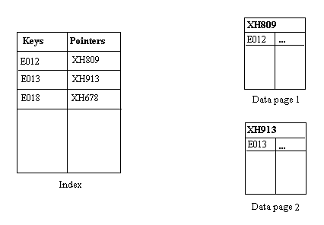
Creating and managing indexes
Pointers store the address of the location where a data page is stored in the memory, as depicted in the following figure.

Slide 5
Creating and managing indexes
Indexes are of the following types:
Clustered index
Nonclustered index

Slide 6
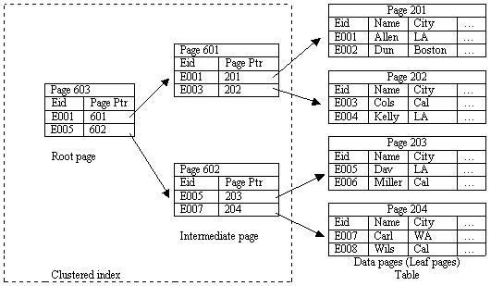
Creating and managing indexes
Clustered index:
It sorts and stores the data rows in the table based on their key values.
The following figure displays a clustered index on the Employee table.

Slide 7
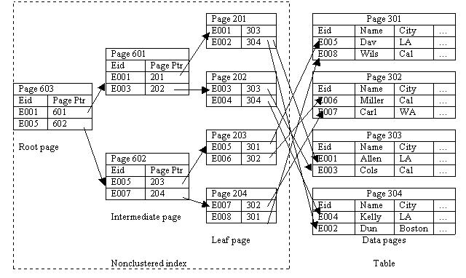
Creating and managing indexes
Nonclustered index:
The physical order of the rows is not the same as the index order.
The following figure represents the working of a nonclustered index.

Slide 8
Creating Indexes
Index:
Is created on the most frequently queried column in tables or views.
Based on two or more columns is called a composite index.
Can be created by using the CREATE INDEX statement.
Syntax:
CREATE [UNIQUE][CLUSTERED | NONCLUSTERED] INDEX index_name
ON [{database_name.[schema_name]. | schema_name.}]
{table_or_view_name}(column [ASC | DESC][,...n])
[WITH(<relational_index_option>[,...n])]
[ON {partition_scheme_name(column_name[,...n])
| filegroup_name | DEFAULT}]
<relation_index_option>::=
{PAD_INDEX = {ON | OFF}
| FILLFACTOR = fillfactor
| ONLINE = {ON | OFF}

Slide 9
Creating Indexes
Asc/Desc
Ascending & descending sort order for index
Pad_Index= (on|off)
Initial fill-factor for index’s non-leaf pages
Fill Factor = <1% – 100%>
Default is index pages are as full as possible minus two records
Fill factor is how full after index is created
Once split goes to 50%
Ignore_dup_key
Circumvent unique key constraint somewhat
Still get error message, but no rollback
useful for storing unique values but trashing transactions
Drop_Existing
Any existing index with same name is dropped with this create statement
More efficient than drop index followed by create for clustered index as no need to touch non-clustered indexes or data pages

Slide 10
Creating Indexes
Online
Keeps table available to users while creating index – sounds good, but ….!!

Slide 11
Creating Indexes
You can create a clustered index on the EmployeeID attribute of the Employee table by using the following statement:
CREATE CLUSTERED INDEX IX_EmployeeID
ON Employee (EmployeeID)
WITH FILLFACTOR = 10
The following statement creates a nonclustered index on the ManagerID attribute of the Employee table:
CREATE NONCLUSTERED INDEX DX_Employee_ManagerID
ON Employee (ManagerID

Slide 12
Creating Indexes
Consider the following guidelines while creating indexes on a table:
Create clustered indexes on columns that have unique or not null values.
Do not create an index that is not used frequently. You require time and resources to maintain indexes.
Create a clustered index before creating a nonclustered index. A clustered index changes the order of rows. A nonclustered index would need to be rebuilt if it is built before a clustered index.
Create nonclustered indexes on all columns that are frequently used in predicates and join conditions in queries.

Slide 13
Creating Indexes
Filtered index:
Allows you to create an index on the specific rows of a column rather than the entire column.
Creates a filter to index a subset of rows within a table.
Helps in reducing the index storage space and maintenance costs as compared to full-table indexes.
Can be created based on a condition specified by the WHERE clause.
For example:
CREATE NONCLUSTERED INDEX FX_EmployeeID
ON HumanResources.Employee(EmployeeID)
WHERE Title= 'Tool Manager'
Creates a filtered index for those records in the Employee table, where the value in the Title column is Tool Manager.

Slide 14
Choosing Clustered Index
Only one per table! - Choose wisely
Default, primary key creates clustered index
Do you really want your prime key to be clustered index?
Option: create table foo myfooExample (column1 int identify primary key nonclustered column2 …. )
Changing clustered index can be costly
How long? Do I have enough space?

Slide 15
Clustered Indexes Pros & Cons
Pros
Clustered indexes best for queries where columns in question will frequently be the subject of
RANGE query (e.g., between)
Group by with max, min, count
Search can go straight to particular point in data and just keep reading sequentially from there.
Clustered indexes helpful with order by based on clustered key
The Cons – two situations
Don’t use clustered index on column just because seems thing to do (e.g., primary key default)
Lots of inserts in non-sequential order
Constant page splits, include data page as well as index pages
Choose clustered key that is going to be sequential inserting
Don’t use a clustered index at all perhaps?

Slide 16
Managing Indexes
The common index maintenance tasks include:
Disabling indexes
Enabling indexes
Renaming indexes
Dropping indexes
Optimizing indexes

Slide 17
Managing Indexes
Disabling indexes:
When an index is disabled, the user is not able to access the index.
If a clustered index is disabled, then the table data is not accessible to the user.
For example:
ALTER INDEX IX_EmployeeID
ON Employee DISABLE

Slide 18
Managing Indexes
Enabling indexes:
Can be achieved by one of the following methods:
Using the ALTER INDEX statement with the REBUILD clause
Using the CREATE INDEX statement with the DROP_EXISTING clause
For example:
ALTER INDEX IX_EmployeeID
ON Employee REBUILD

Slide 19
Managing Indexes
Renaming indexes:
Can be done with the help of the sp_rename system stored procedure.
For example:
EXEC sp_rename
'HumanResources.JobCandidate.IX_JobCandidate_
EmployeeID', 'IX_EmployeeID','index'

Slide 20
Managing Indexes
Dropping indexes:
Can be done using the DROP INDEX statement.
For example:
DROP INDEX IX_EmployeeID
ON Employee

Slide 21
Summary
In this session, you learned that:
Indexes are created to enhance the performance of queries.
There are two types of indexes, clustered and nonclustered.
Clustered indexes should be built on an attribute whose values are unique and do not change often. Data is physically sorted in a clustered index.
In a nonclustered index, the physical order of rows is not the same as that of the index order.
A nonclustered index is the default index that is created with the CREATE INDEX command.
Managing Indexes

